Slide 1




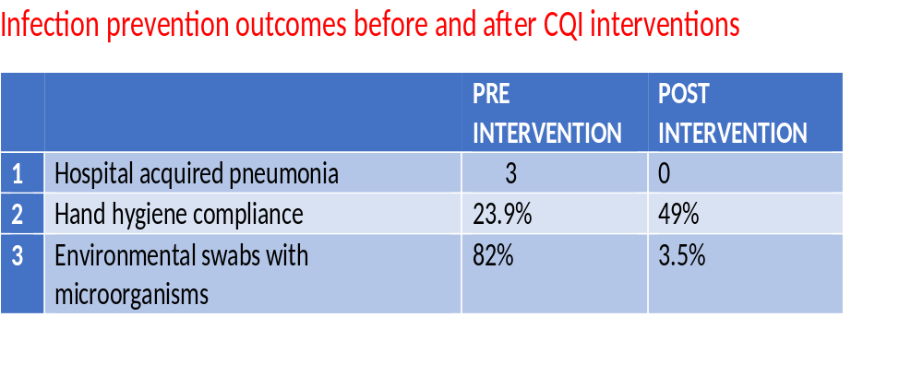
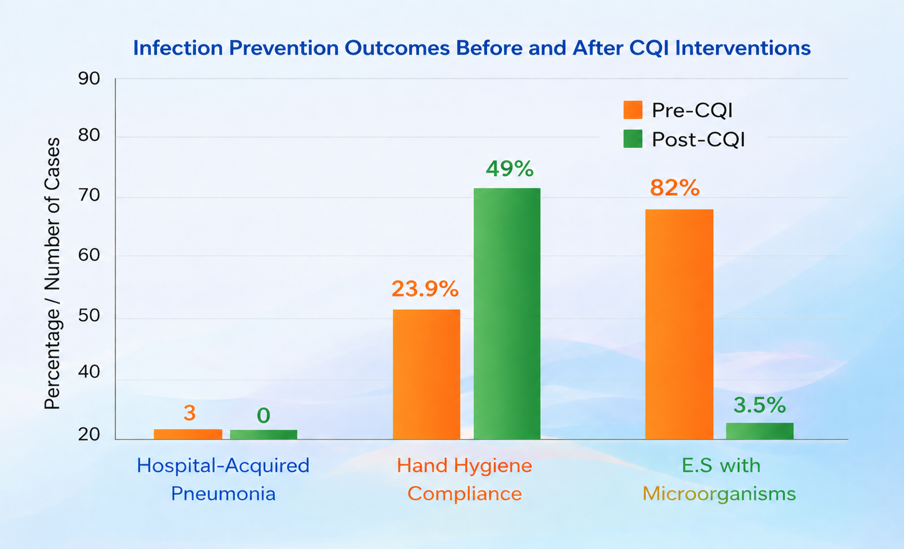
HOSPITAL-ACQUIRED INFECTIONS AUDIT AND QUALITY IMPROVEMENT INTERVENTIONS AT MURANG’A COUNTY REFERRAL HOSPITAL ICU
z kinuthia^{1,} , F kagwaini¹ R Kuria¹
1: Department of Health, Murang’a county, Kenya.
BACKGROUND
Hospital-acquired infections (HAIs), are infections that occur in patients while seeking healthcare in hospitals and health facilities which were not present at time of admission or the hospital visit.
The burden of HAIs is not well quantified with estimated 7% in developed and 10% in developing countries being at risk of developing at least one HAI despite being preventable.
They are of significant public health concern because they contribute to increased morbidity, mortality, prolonged hospital stay, and healthcare costs (Mihnea Miron et al, 2024).
In Murang’a county referral hospital In the month of October and November 2025 a data review observed a surge in HAP case ,3 out of 5 post-craniotomy patients in ICU developed hospital acquired pneumonia, prompting the need for an Infection Prevention and Control (IPC) audit and adoption of a Continuous Quality Improvement (CQI) model to design and implement targeted interventions.
OBJECTIVE:
.To reduce hospital-acquired infections in the ICU at Murang’a County Referral Hospital through targeted quality improvement interventions
METHODOLOGY:
Pre and post intervention audit was done. Patient level data was reviewed and abstracted from medical records, surface environmental swabs from disinfected equripment's, instruments and surroundings collected, hand hygiene practices among the health workers audited, instrument reprocessing of reusable medical equipment and environmental cleaning, laboratory based microbiology culture of collected samples,
Pre- and Post- IPC audit conducted using the facility IPC audit tool. Continuous Quality Improvement (CQI) model application was adopted to design and implement targeted interventions. .
Following identification of gaps pre intervention, a multipronged intervention strategy was implemented, including staff training, provision of IPC supplies, infrastructure improvements, enhanced environmental cleaning, visitor restriction, and weekly supervision
Data was summarized and analyzed using Microsoft Excel.
STUDY AREA: MCRH,Murang’a county, Kenya
DISCUSSION
Pre intervention audit found 3 hospital acquired pneumonia cases in ICU Environmental sampling showed that 23/28 (82%) swabs had microbial growth, including Acinetobacter baumannii, coagulase-negative Staphylococcus, and Staphylococcus aureus. Hand hygiene compliance among the health workers was 23.9%
Post-intervention, there was 0 cases of hospital acquired pneumonia in ICU, only 1/28 (3.5%) swabs demonstrated microbial growth, indicating a marked reduction in environmental contamination. No cases of HAP were recorded following the interventions, and sustained adherence to IPC measures has maintained zero hospital acquired pneumonia incidence to date.
RESULTS
Table 1
CONCLUSIONS
The implementation of targeted IPC interventions following an audit significantly reduced environmental contamination and lowered the risk of HAP in the ICU. Strict adherence to infection prevention and control measures, conducting regular IPC audits, continuous staff training, adequate resource provision, and continuous monitoring are critical in improving patient safety and preventing HAIs. To effectively establish causality, patient microbiological profile need to be compared to that of the environmental contamination
Contact: zackinuthia@gmail.com

